Slide 1
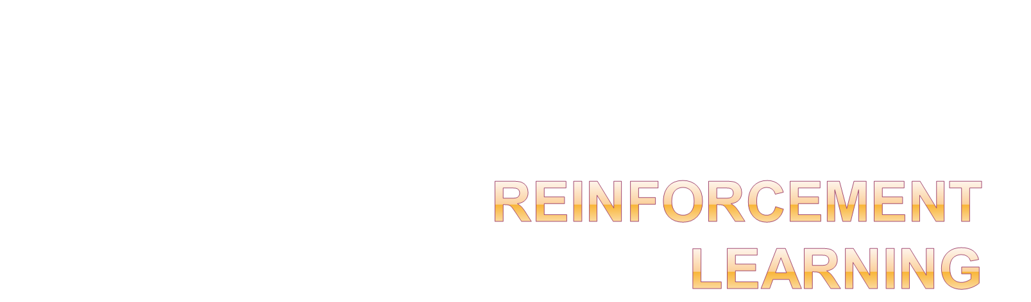
Dr. Mridu Sahu

Slide 2
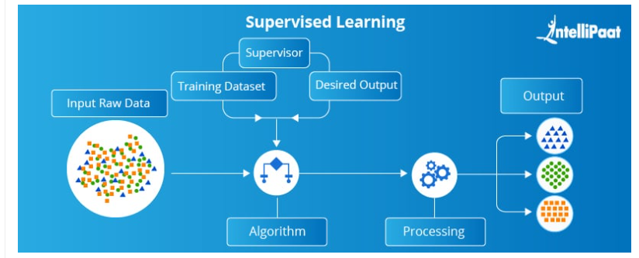

Slide 3
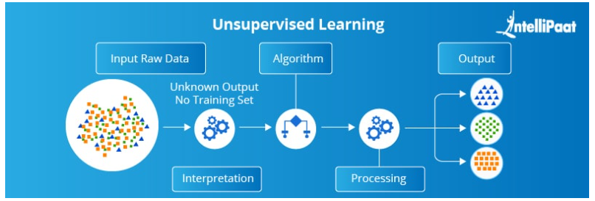

Slide 5
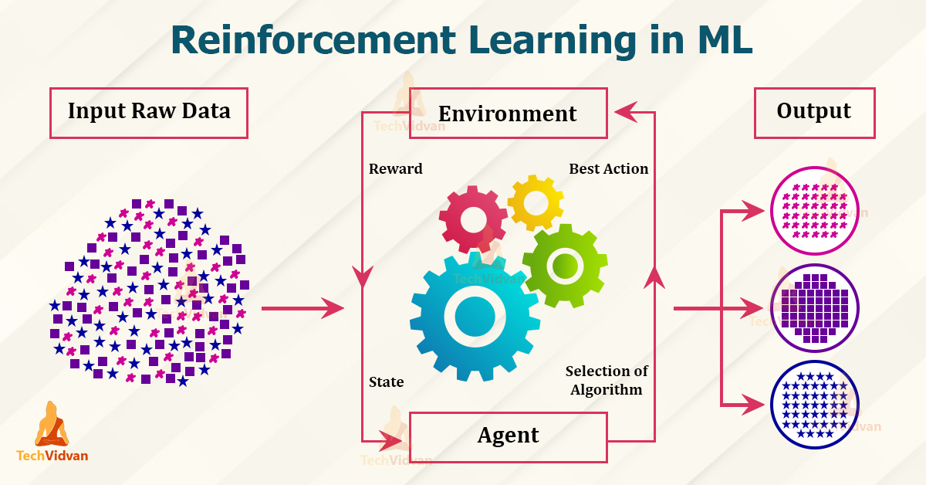

Slide 6
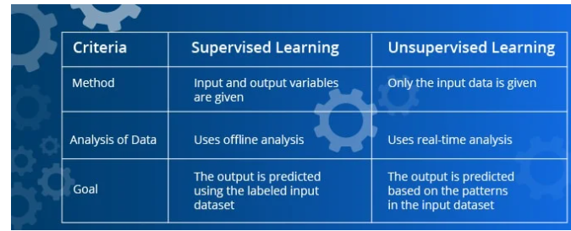

Slide 7
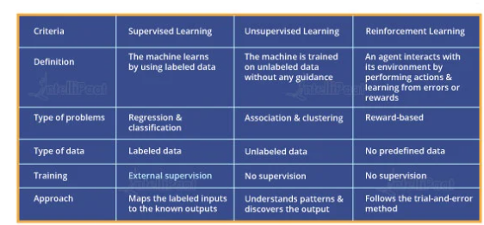

Slide 8
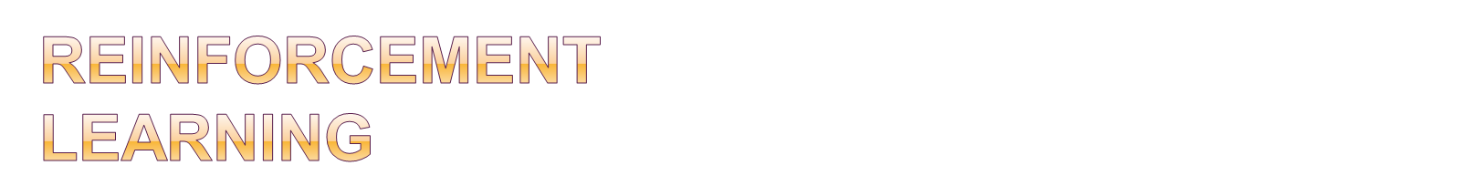
Reinforcement Learning is a feedback-based Machine learning technique in which an agent learns to behave in an environment by performing the actions and seeing the results of actions. For each good action, the agent gets positive feedback, and for each bad action, the agent gets negative feedback or penalty.
In Reinforcement Learning, the agent learns automatically using feedbacks without any labeled data, unlike supervised learning.
Since there is no labeled data, so the agent is bound to learn by its experience only.
RL solves a specific type of problem where decision making is sequential, and the goal is long-term, such as game-playing, robotics, etc.

Slide 9
It is a core part of Artificial intelligence, and all AI agent works on the concept of reinforcement learning. Here we do not need to pre-program the agent, as it learns from its own experience without any human intervention.
Example: Suppose there is an AI agent present within a maze environment, and his goal is to find the diamond. The agent interacts with the environment by performing some actions, and based on those actions, the state of the agent gets changed, and it also receives a reward or penalty as feedback.
The agent continues doing these three things (take action, change state/remain in the same state, and get feedback), and by doing these actions, he learns and explores the environment.
The agent learns that what actions lead to positive feedback or rewards and what actions lead to negative feedback penalty. As a positive reward, the agent gets a positive point, and as a penalty, it gets a negative point.

Slide 10
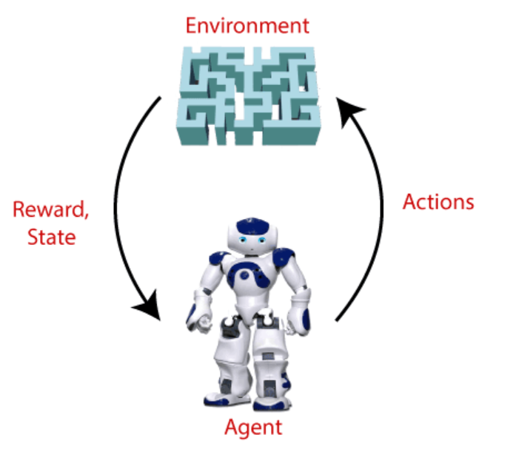

Slide 11
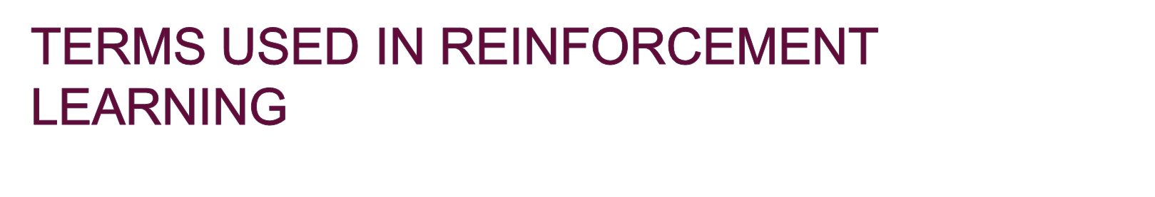
Agent(): An entity that can perceive/explore the environment and act upon it.
Environment(): A situation in which an agent is present or surrounded by. In RL, we assume the stochastic environment, which means it is random in nature.
Action(): Actions are the moves taken by an agent within the environment.
State(): State is a situation returned by the environment after each action taken by the agent.
Reward(): A feedback returned to the agent from the environment to evaluate the action of the agent.
Policy(): Policy is a strategy applied by the agent for the next action based on the current state.
Value(): It is expected long-term retuned with the discount factor and opposite to the short-term reward.
Q-value(): It is mostly similar to the value, but it takes one additional parameter as a current action (a).

Slide 12


Slide 13

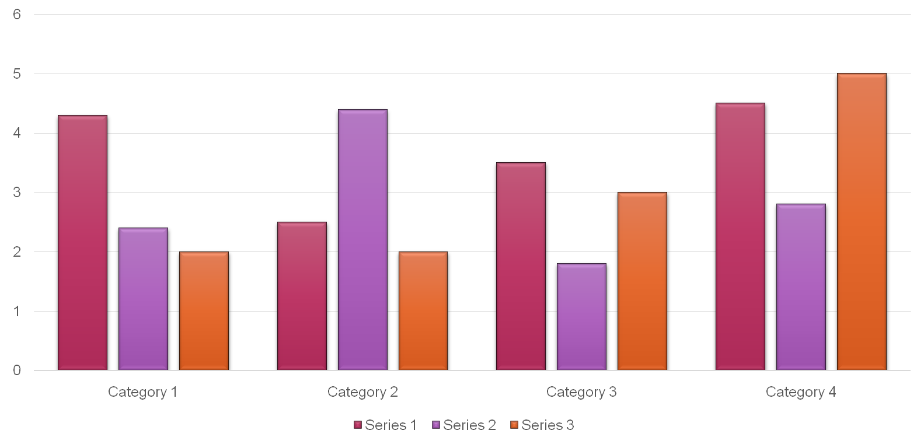

Slide 14
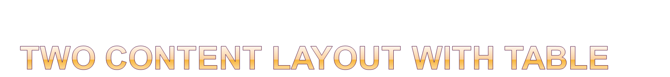
Class | Group A | Group B
Class 1 | 82 | 85
Class 2 | 76 | 88
Class 3 | 84 | 90
First bullet point here
Second bullet point here
Third bullet point here

Slide 15

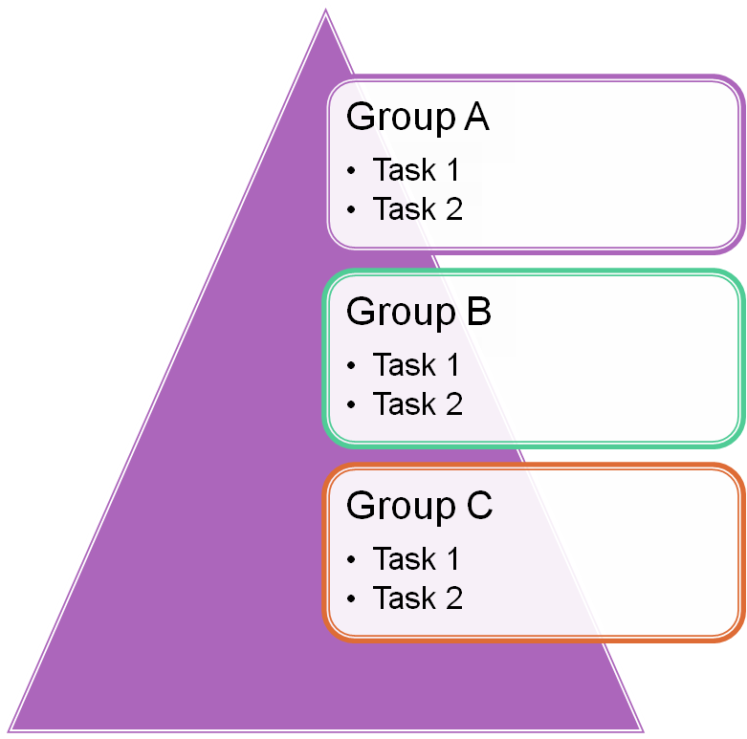
First bullet point here
Second bullet point here
Third bullet point here

